Slide 1
PROJECT TITLE : Self-Learning Bot(Medic-Bot)
PIP104 University Project-III
Review-3
Batch Number:
COM-G10
Roll Number | Student Name
20201CEI0077 | KRISHNAN S
20201CEI0030 | RIHAN ANWAR C A
20201CEI0001 | AMBRISH KUMAR S
20201CEI0011 | S MOHAMMED ENTHIHAJ
Under the Supervision of,
Mr. Muthu Raju V
Assistant Professor
School of Computer Science & Engineering
Presidency University

Slide 2
Introduction
The topic "Self-Learning Bot in the Medical Sector" explores the application of chatbots and natural language processing (NLP) in healthcare. It explores into the creation of conversational chatbots designed to engage with elderly individuals, track health trends, and deliver fundamental health information. The document discusses the incorporation of machine learning algorithms, specifically KNN, for evaluating symptoms and the integration of external APIs to enhance NLP capabilities. It emphasizes the pivotal role of these technologies in automating user communication and providing crucial health information. Furthermore, the topic explains on the processes of data collection, feature extraction, and system testing.
It also highlights the potential of chatbots to streamline healthcare processes, saving both time and money also underscores the broad and optimal experiences that chatbots can offer across diverse applications. It ultimately emphasizes the transformative impact of NLP-powered chatbots on the medical sector, enhancing patient care and accessibility to vital medical information.
The use of chatbots and natural language processing (NLP) in healthcare has received great attention in recent years. With the demand for healthcare services increasing and the number of doctors decreasing, chatbots have emerged as a promising way to provide advice and assistance to patients.

Slide 3
Literature Review
Title | Author | Published Date | Technology used
PERSONAL HEALTHCARE CHATBOT FOR MEDICAL SUGGESTIONS USING ARTIFICIAL INTELLIGENCE AND MACHINE LEARNING | R Jegadeesan Dava Srinivas N Umapathi G Karthick N Venkateswaran | 13, July 2023 | Healthcare chatbot KNN-Machine Learning NLP-Artificial Intelligence Retrieval-based algorithm
HEALTHCARE CHATBOT | Athulya N Jeeshna K S J Aadithyan U Sreelakshmi Hairunizha Alias Nisha Rose | 21 ,Oct 2021 | Recommendation System Machine Learning Recommendation models Content filtering Collaborative filtering
Bots using Natural Language Processing in Medical Sector | Ramni Harbir Singh Sargam Maurya Tanisha Tripathi Tushar Narula Gaurav Srivastav | 5, June 2020 | Recommendation System Content-Based Recommender System Deep learning

Slide 4
Literature Review
Title | Author | Published Date | Technology used
Conversational Bot for Pharmacy: A Natural Language Approach | Nur Syahirah Ahmad Mohd Hamim Sanusi Mohd Helmy Abd Wahab Aida Mustapha Zainal Abidin Sayadi | 1, June 2022 | Natural Language Processing Cosine Similarity Algorithm Artificial Intelligence User Interface Machine Learning
Nurse-Bot: A Robot System Applied to Medical Assistance | Jesus Alvarez Guillermo Campos Valeria Enr ıquez Alexis Miranda Francisco Rodriguez Hiram Ponce | 16, Oct 2023 | Recommendation System Machine Learning Content filtering Collaborative filtering
Advanced Healthcare Chat Bot using Python | S Santhosham Chitranjan Prasad Sah | 3, March 2023 | Chatbot HealthCare Natural Language Processing.

Slide 5
Literature Review
Title | Author | Published Date | Technology used
Artificial Intelligence based Healthcare Chat Bot System | Akash Goel Satyam Shubham Sharma | 1, June 2023 | Healthcare Chat bot Artificial Intelligence Chatterbot Symptoms Health Database
Automatized Medical Chatbot (Medibot) | Prakhar Srivastava Nishant Singh | 28 ,Feb 2022 | Human-machine interaction Medical Chatbot Natural Language Processing Machine Learning
E-Health Bot to change the Face of Medicare | Tushar Tanmay1 Akanksha Bhardwaj Shilpi Sharma | 16,oct 2023 | Artificial Intelligence Machine Learning Chatbot Natural Language Understanding

Slide 6
Literature Review
Title | Author | Released Date | Technology Used
Self-Supervised Bot Play for Conversational Recommendation with Justifications | Shuyang Li Bodhisattwa Prasad Majumder Julian McAuley | 09,Dec 2021 | conversational recommendation recommender system
Using an Internet Bot to Predict the Spread of COVID-19 | Ivan Dyyak Bohdan Melnyk Nataliya Melnyk Stepan Trokhaniak Tetiana Drakohrust | 16,Oct 2021 | COVID-19 pandemic Bot Model Forecasting Bayesian inference
Deployment of Medibot in Medical Field | P Reshmanth P Sushanth Chowdary Yogitha R R Aishwarya | 16,Oct 2023 | Deep Learning Machine Learning Medi bot Symptoms Artificial Intelligence Natural Language Processing

Slide 7
Proposed Method
1. Data Collection and Preprocessing:
Gather a diverse dataset of medical texts, including textbooks, research papers, and reputable online sources. Preprocess the data to remove noise, standardize formatting, and ensure consistency.
2. Natural Language Processing (NLP):
Implement NLP techniques to understand and analyze medical text, including named entity recognition, part-of-speech tagging, and sentiment analysis.
3. Machine Learning Algorithms:
Employ machine learning algorithms, such as support vector machines, decision trees, or deep learning models like recurrent neural networks (RNNs) or transformers, for intent classification and entity recognition.
4. Dialog Management:
Implement a dialogue management system to maintain context, handle multi-turn conversations,
and generate appropriate responses based on the chatbot's training.

Slide 8
Proposed Method
5. Reinforcement Learning:
Integrate reinforcement learning techniques to allow the chatbot to learn and optimize responses through trial-and-error interactions, adapting to user feedback.
6. User Feedback Loop:
Establish a mechanism for collecting user feedback on the chatbot's responses to continuously improve its performance and accuracy.
7. Continuous Learning and Updating:
Implement mechanisms for periodic updates and retraining of the chatbot using new medical data to keep the information up-to-date and accurate.
8. Privacy and Security Measures:
Incorporate stringent privacy and security measures to ensure the confidentiality and protection of sensitive medical data shared during interactions.

Slide 9
Objectives
Enhance User Experience and Accessibility
2. Improve Accuracy and Relevance of Responses
3. Enable Continuous Learning and Adaptability
4. Ensure Privacy and Data Security
5. Integration with Healthcare Systems

Slide 10
Methodology
1. Data Collection and Preparation:
Collect a diverse dataset of medical literature, research papers, clinical notes, and publicly available healthcare information to form the basis of the chatbot's knowledge.
2. Natural Language Processing (NLP):
Utilize named entity recognition (NER) and part-of-speech tagging to identify medical entities, relationships, and categories within the text.
3.Machine Learning and Deep Learning Models:
Develop machine learning models, such as support vector machines (SVM) or decision trees, to classify intents and extract key medical entities from user queries.

Slide 11
Methodology
4. Reinforcement Learning and Feedback Loop:
Implement a reinforcement learning approach to continually improve the chatbot's responses based on user feedback and interactions.
5. Iterative Development and Evaluation:
Adopt an iterative development approach, where the chatbot is continually updated, refined, and expanded with new medical data and improved algorithms.
6. Decision Tree:
Decision trees are a popular machine learning algorithm that can be used for both classification and regression tasks.

Slide 12
Timeline of Project
Week 1: Project Inception and Data Collection(09/09/2023)
Day 1-2: Project kickoff, team formation, and goal alignment.
Day 3-4: Define project scope, objectives, and establish key performance indicators (KPIs).
Day 5-7: Research and select suitable datasets and sources for medical data collection.
Week 2: Project Inception and Data Collection(10/11/2023)
Day 1-3: Collect and curate the selected medical datasets for preprocessing.
Day 4-5: Begin data preprocessing (cleaning, formatting, and structuring).
Day 6-7: Document data preprocessing procedures and initial findings.
Week 3: Implementing Natural Language Processing (27/11/2023)
Day 1-2: Implement basic NLP techniques on preprocessed data (tokenization, stop-word removal, etc.).
Day 3-4: Begin developing machine learning models for intent classification and entity extraction.
Day 5-7: Evaluate and refine the initial machine learning models.

Slide 13
Week 4:Model Development(08/12/2023)
Day 1-2: Explore and experiment with advanced NLP models and deep learning architectures
Day 3-5: Train and fine-tune the models using the preprocessed medical data.
Day 6-7: Evaluate model performance, choose the most effective model, and document the results.
Week 5: Integration, User Feedback Loop, and Continuous Learning(26/12/2023)
Day 1-3: Integrate the selected machine learning model into the chatbot interface.
Day 4-5: Implement a user feedback mechanism and set up the feedback loop for continuous learning.
Day 6-7: Conduct initial usability testing and gather feedback for improvements.
Week 6: Refinement, Testing, and Final Presentation(8/01/2024)
Day 1-3: Incorporate feedback and make necessary refinements to the chatbot's interface and functionality.
Day 4-5: Conduct comprehensive testing, including stress testing and edge case analysis.
Day 6-7: Finalize the presentation, including results, learnings, and future recommendations.
Timeline of Project

Slide 14
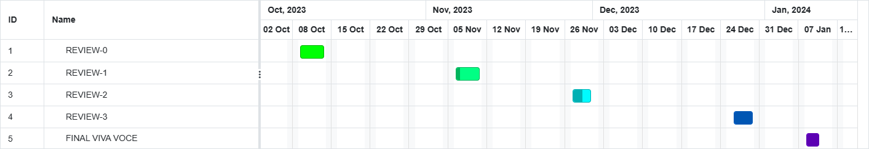
Timeline of Project

Slide 15
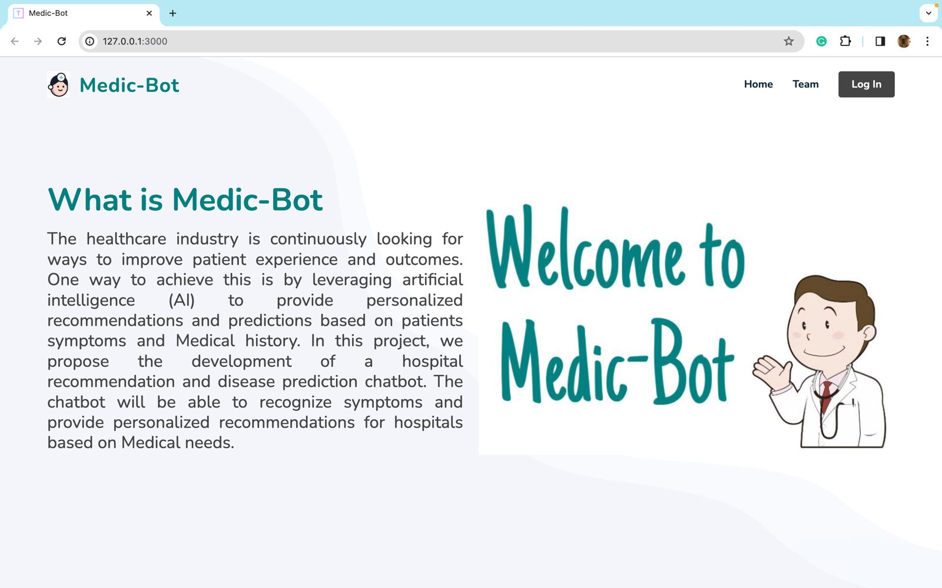
Outcomes

Slide 16
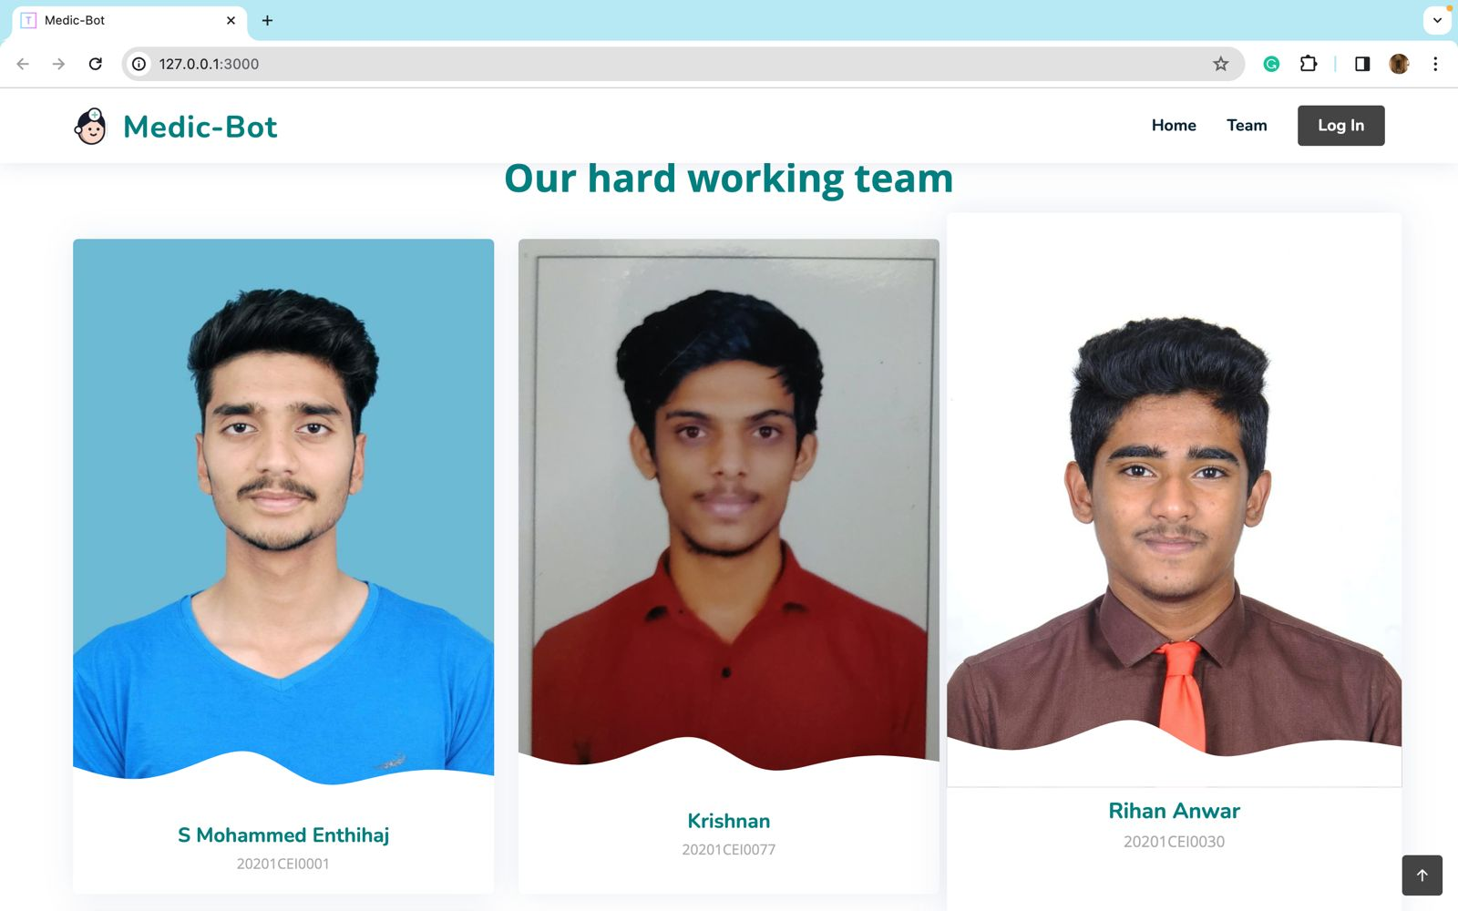
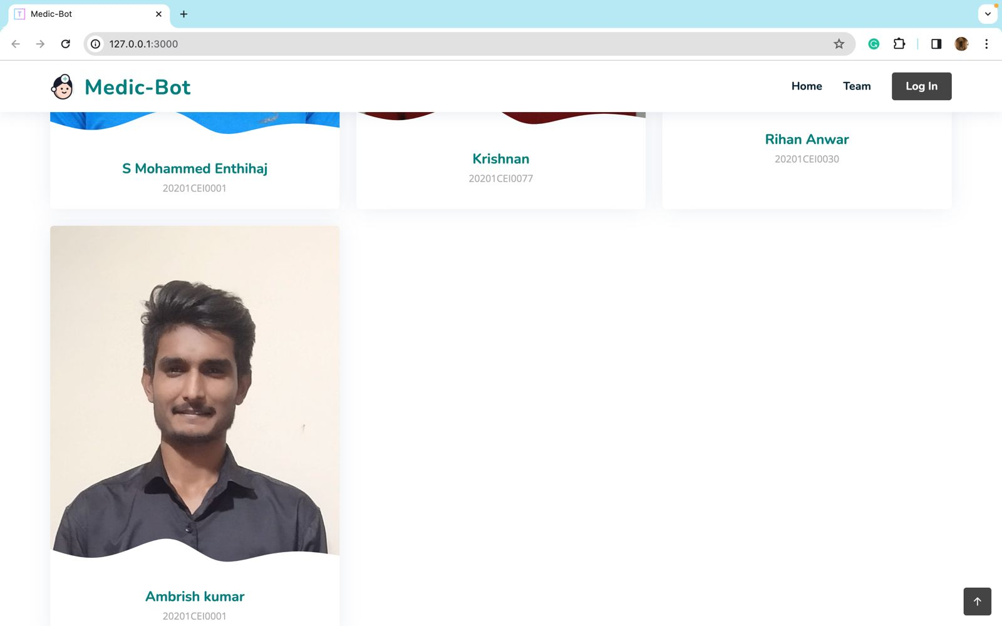
Outcomes

Slide 17
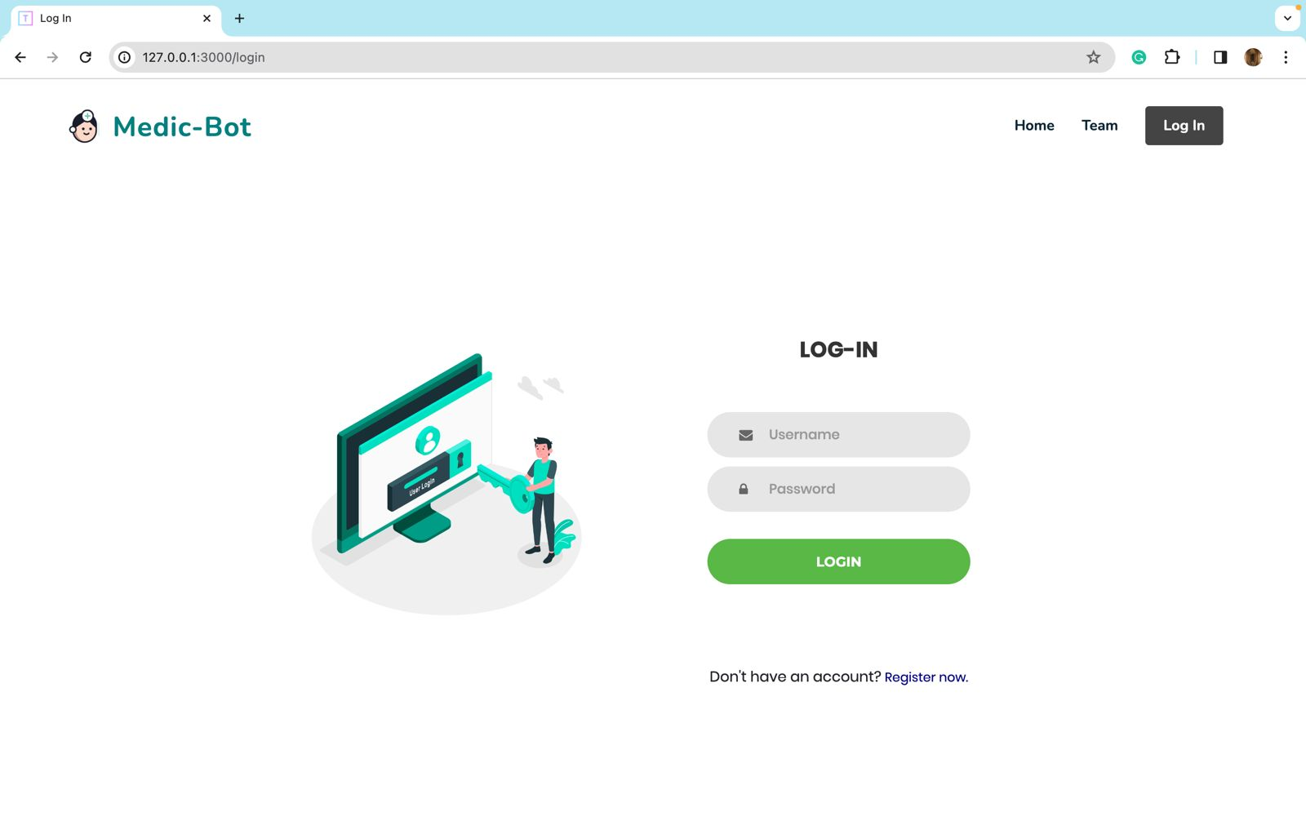
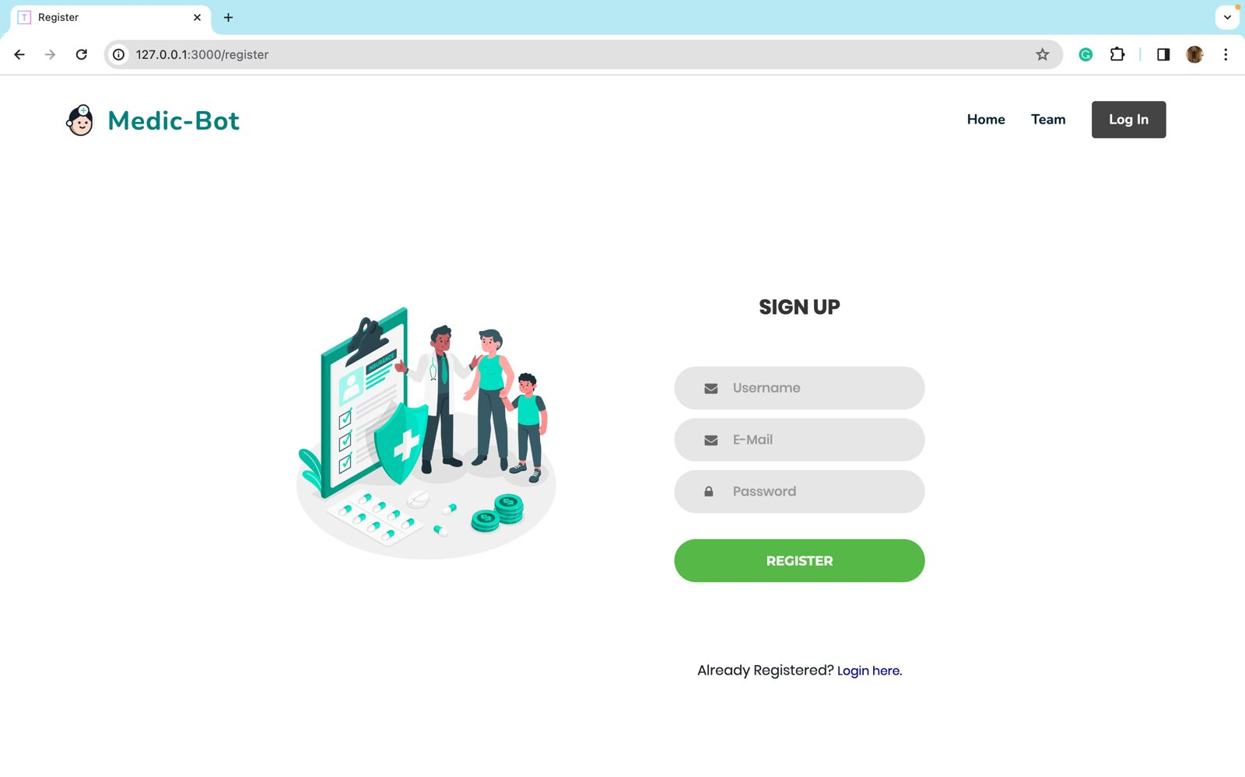
Outcomes

Slide 18
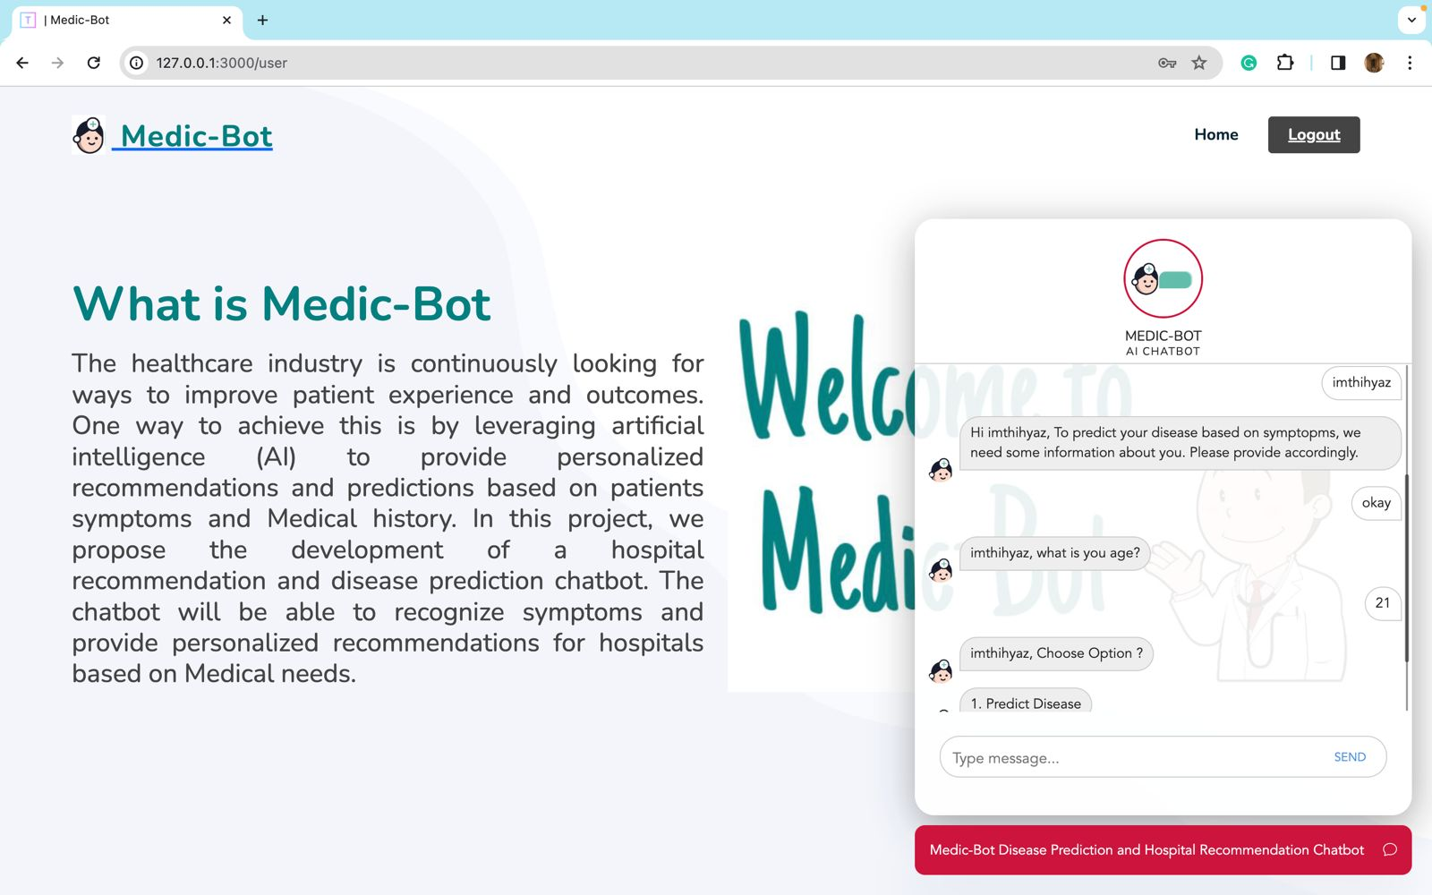
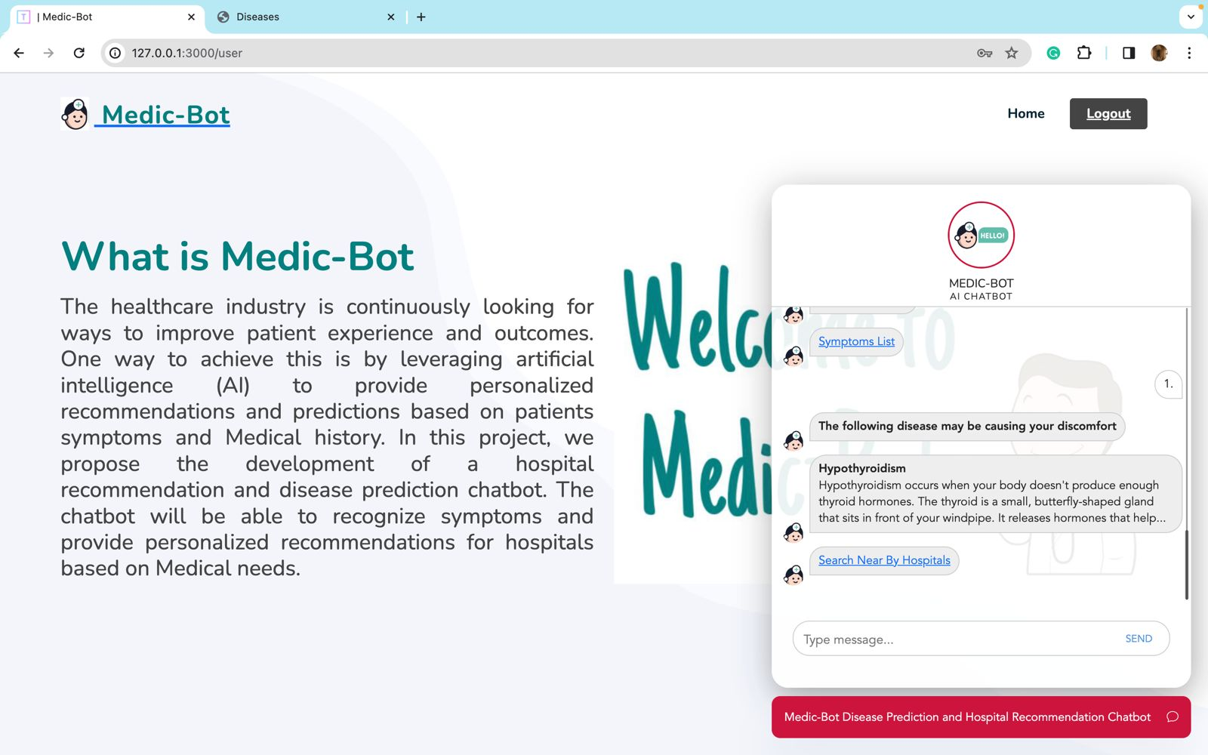
Outcomes
Done with the bot’s part

Slide 19
Conclusion
In conclusion, our plan outlines a strong method for creating an advanced healthcare chatbot. We're using various sets of information, smart language understanding, and knowledge graphs to make the chatbot better. The goal is to enhance user experience, improve response accuracy, and enable continuous learning. Machine learning and deep learning form the core of the chatbot's abilities, ensuring adaptability and relevance.
In addition to these technical aspects, we've incorporated a user feedback loop, continuous learning mechanisms, and strict privacy measures. This demonstrates our commitment to user satisfaction, data security, and personalized healthcare guidance. Our iterative and comprehensive development process aims to create a self-learning medical chatbot that evolves with new information, user feedback, and changing healthcare contexts. We've successfully completed our project, and everything is done and working correctly.

Slide 20
References
[1] Shali, Prashanth, Rishi G, Shriram, Assel, Naskath,(2022)'Bots using Natural Language Processing in Medical Sector' 2022 1st International Conference on Computational Science and Technology(ICCST)|978-1-6654-7655-3/22/$31.00©2022IEEE
[2] Santhosham, Prasad Sah C,(2023)'Advanced Healthcare Chat Bot Using Python'2023 2nd International Conference for Innovation in Technology (INOCON) | 979-8-3503-2092-3/23/$31.00 ©2023 IEEE | DOI: 10.1109/INOCON57975.2023.10101239
[3] Syahirah Ahmad N, Hamim Sanusi M, Helmy Abd Wahab M, Mustapha A, Abidin Sayadi Z, Zainuri Saringat M,(2018)'Conversational Bot for Pharmacy: A Natural Language Approach' in IEEE Xplore
[4] Tanmay T, Bhardway A, Sharma S,(2020)'E-Health Bot to Change the Face of Medicare' 2020 Research, Innovation, Knowledge Management and Technology Application for Business Sustainability (INBUSH)|978-1-7281-1769-0/20/$31.00©2020IEEE
[5] Goel A, Satyam, Sharma S,(2023)'Artificial Intelligence base Healthcare Chat Bot System'2023 8th International Conference on Communication and Electronics Systems (ICCES) | 979-8-3503-9663-8/23/$31.00 ©2023 IEEE | DOI: 10.1109/ICCES57224.2023.10192727
[6] Srivastava P, Singh N,(2020)'AUtomatized Medical Chatbot(Medibot)'2020 International Conference on Power Electronics & IoT Applications in Renewable Energy and its Control (PARC) 978-1-7281-6575-2/20/$31.00 ©2020 IEEE 10.1109/PARC49193.2020.236624

Slide 21
References
[7] Athulya N, Jeeshna K, S J Aadithyan, U Sreelakshmi, Hairunizha Alias Nisha Rose,(2021)'Healthcare Chatbot'9(10)| ISSN: 2320-2882
[8] Alvarez J, Campos G, Enriquez V, Miranda A, Rodriguez F, Ponce H,(2018)'Nurse-Bot: A RObot System Applied to Medical Assistance'2018 International Conference on Mechatronics, Electronics and Automotive Engineering (ICMEAE)
[9] R Jegadeesan, Dava Srinivas, N Umapathi, G Karthick, N Venkateswaran(2023)'Personal Healthcare Chatbot for Medical suggestions using Artificial Intelligence and Machine Learning'Section A-Research paper
[10] Shuyang Li, Prasad Majumder B, McAuley J,(2021)'Self-Supervised Bot play for Conversational Recommendation with Justifications'arXiv:2112.05197v1 [cs.CL] 9 Dec 2021
[11] Dyyak I, Melnyk B, Melnyk N, Trokhaniak S, Drakohrust T, Svitlak I,(2021)'Using an Internet Bot to Predict the Spread of COVID-19'2021 11th International Conference on Advanced Computer Information Technologies (ACIT) | 978-1-6654-1854-6/21/$31.00 ©2021 IEEE | DOI: 10.1109/ACIT52158.2021.9548345
[12] Reshmanth P, Sushanth Chowdary p, Yogitha R, Aishwarya R,(2022)'Deployment of Medibot in Medical Field'2022 International Conference on Sustainable Computing and Data Communication Systems (ICSCDS)978-1-6654-7884-7/22/$31.00 ©2022 IEEE |DOI: 10.1109/ICSCDS53736.2022.9760900

Slide 22
Thank You

